Slide 1
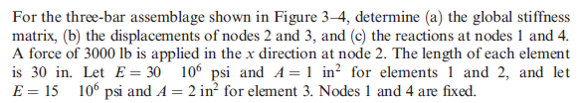
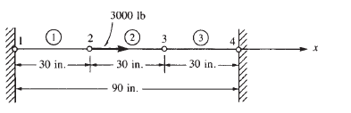
Example1

Slide 2
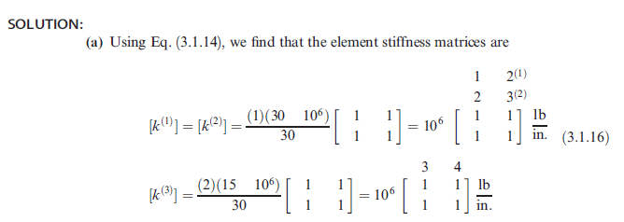
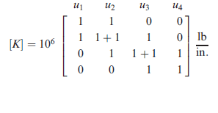

Slide 3
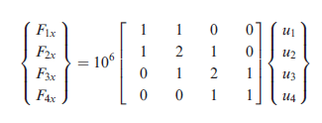



Slide 4
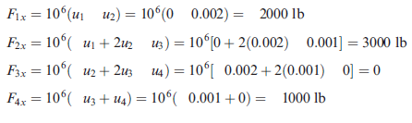

Slide 5
Example2
A simple plane truss is made of two identical bars (with E, A, and L), and loaded as shown in the figure. Find
1) displacement of node 2;
2) stress in each bar.

Slide 6
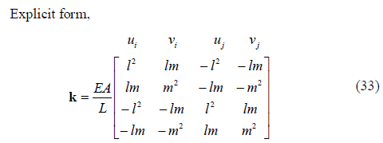
Solution
Step 1: Obtaining the direction cosines of the elements
Element 1:
Element 2:
Step 2: Calculation of element matrices in global coordinate system

Slide 7
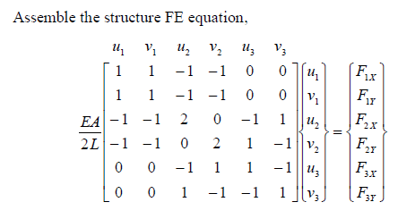
Solution
K₁
K₂
Step 3: Assembly of global FE matrices

Slide 8
Solution
Step 4: Applying boundary conditions
Step 5: Solving the FE matrix equation

Slide 9
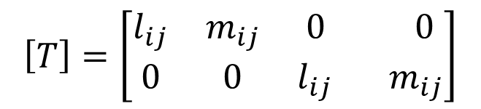
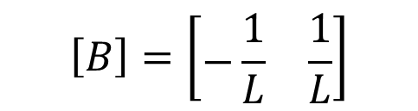
Solution
To obtain the stresses in the elements,

Slide 10
Example3
Solve the two-bar truss supported by a spring shown in the figure below. Both bars have E=210 GPa and A =5.0×10⁻⁴ m². Bar one has a length of 5m and bar two a length of 10m. The spring stiffness is k = 2000 kN/m.

Slide 11
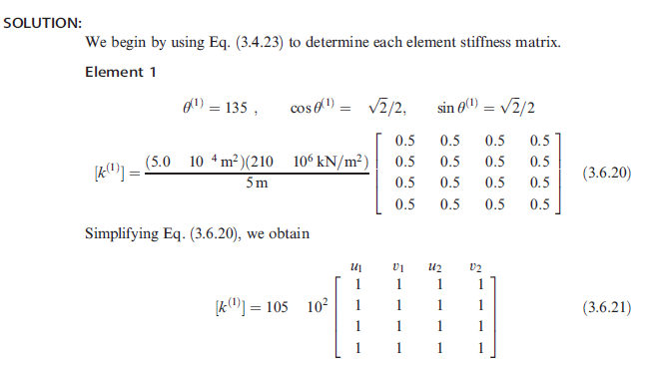

Slide 12
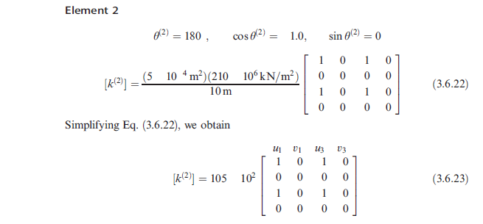

Slide 13
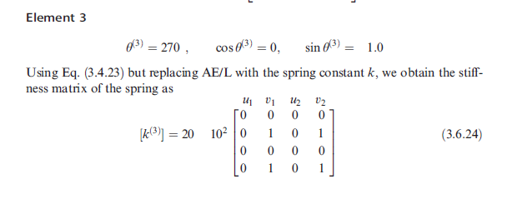

Slide 14
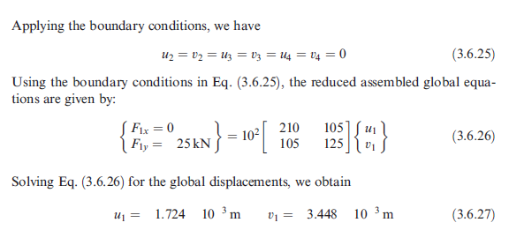

Slide 15
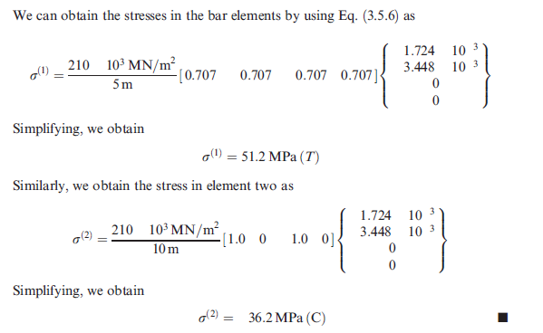

Slide 16
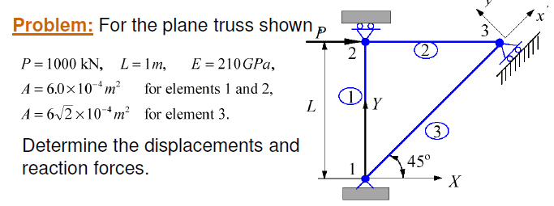
Example4

Slide 17
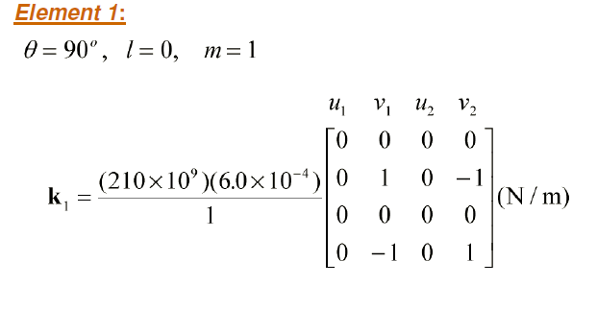
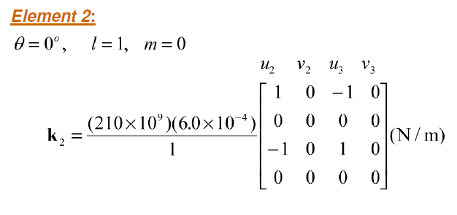

Slide 18
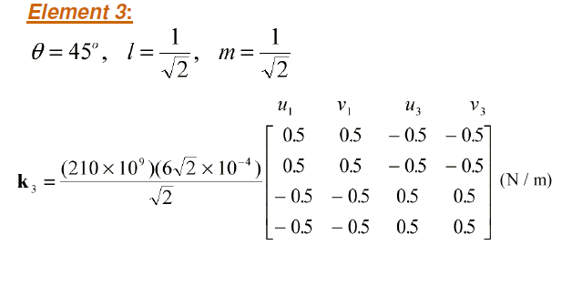
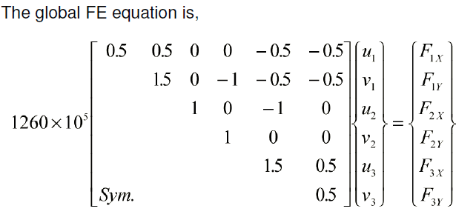

Slide 19
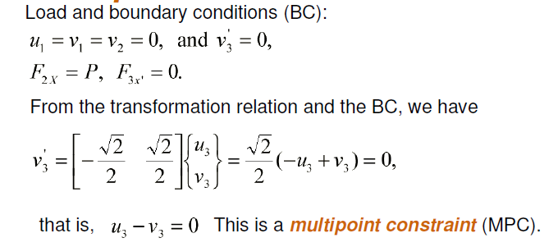
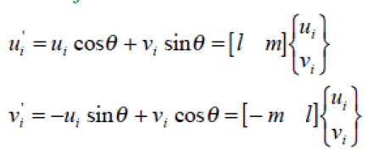
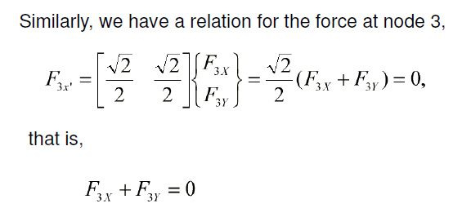

Slide 20
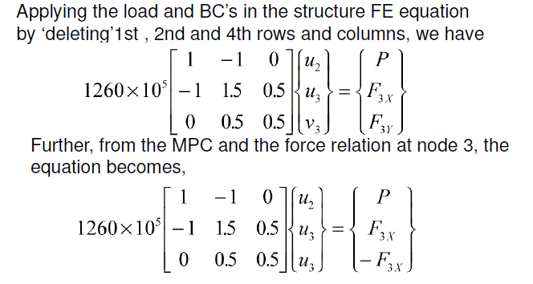

Slide 21
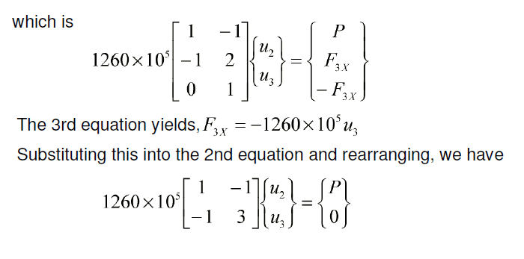

Slide 22
